Slide 1

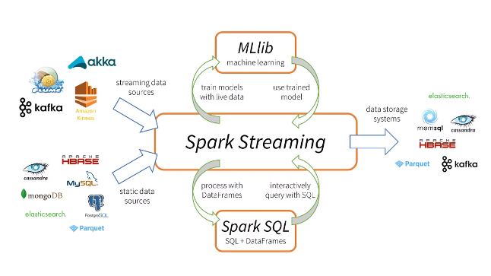
What is PySpark?
PySpark is a Python library for working with Apache Spark, a powerful distributed computing framework. It provides a high-level API for writing Spark applications in Python, allowing you to process large datasets and perform complex computations in a distributed manner.
S

Slide 2

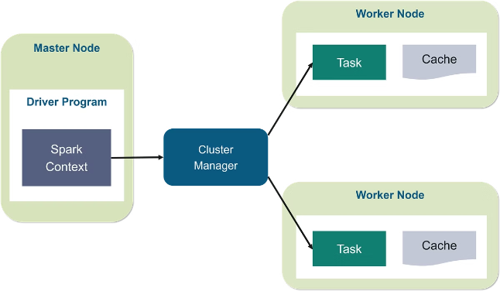
Advantages of PySpark
1
Scalability
2
Speed
PySpark allows you to process massive datasets efficiently, leveraging the power of distributed computing.
Its in-memory processing capabilities enhance performance, leading to faster execution times.
3
Ease of Use
4
Rich Ecosystem
PySpark offers a user-friendly API that simplifies complex data processing tasks.
With libraries for machine learning, SQL, and more, PySpark offers a versatile environment for data exploration and analysis.

Slide 3
Python vs Scala for Spark
Python
Scala
Python's simplicity and large community make it a popular choice for beginners. It's also great for data analysis and machine learning.
Scala is a more powerful language, but with a steeper learning curve. It's a good choice for large-scale projects and high-performance computing.
Ease of use
Type safety
Widely adopted
Performance optimization
Rich libraries
Functional programming features

Slide 4
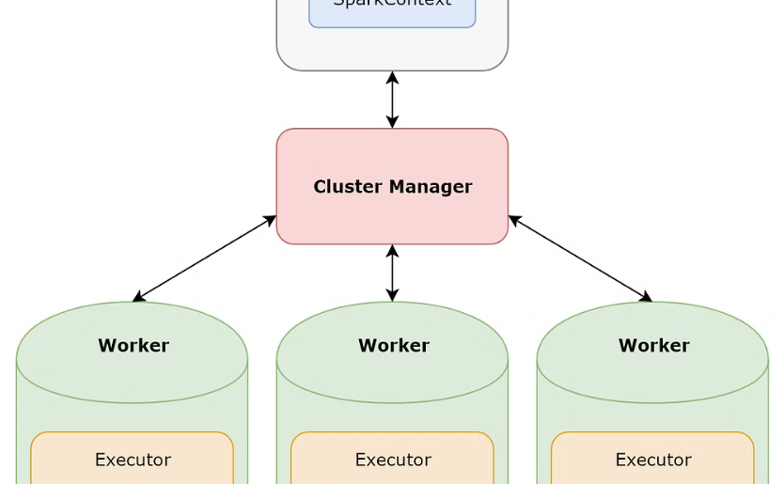
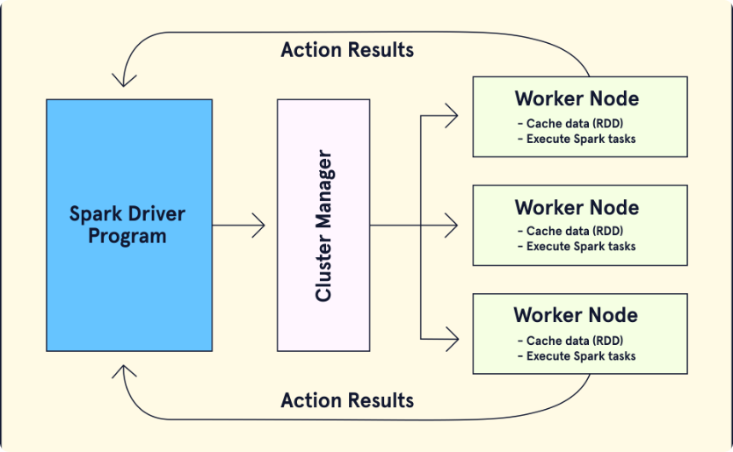
SparkContext with Architecture
Worker Nodes
Driver Program
Execute tasks assigned by the driver program, processing data in parallel.
Coordinates the execution of tasks across the cluster and manages the SparkContext.

Slide 5
PySpark Fundamentals
SparkContext
SparkConf
RDD
The entry point for interacting with Spark, creating RDDs, and managing the cluster.
Configures Spark application properties, such as master URL and application name.
Resilient Distributed Datasets, a fundamental data structure in Spark that represents a collection of data distributed across multiple nodes.
DataFrame
MLlib
A tabular data structure with named columns, providing a structured interface for data manipulation and analysis.
Spark's machine learning library, providing algorithms for classification, regression, clustering, and more.

Slide 6
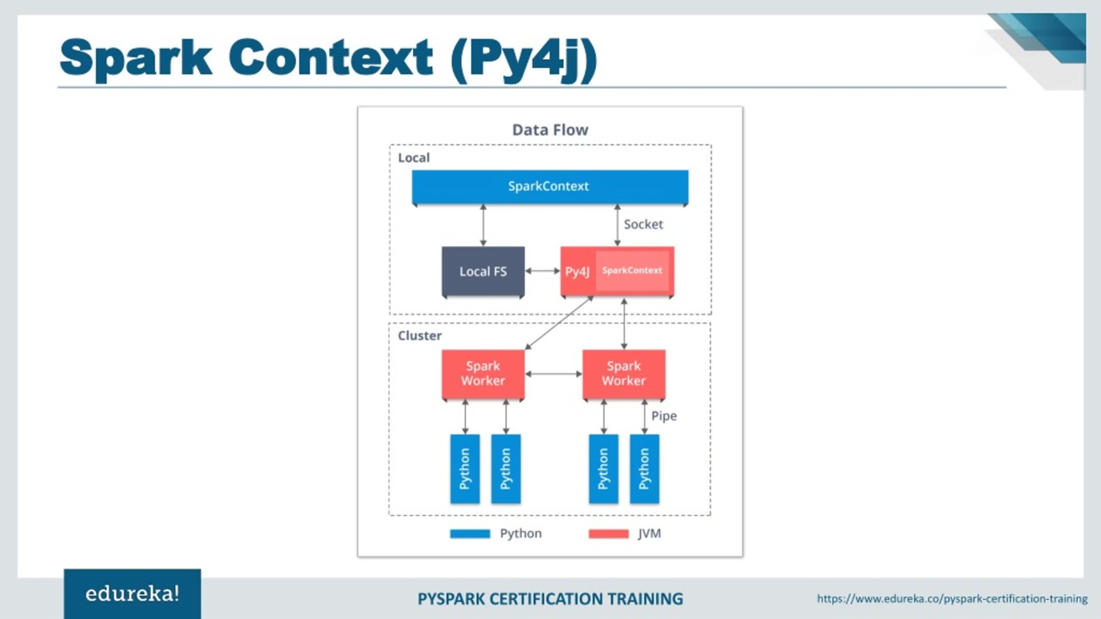
What is SparkContext?
Purpose
The entry point to interact with Spark.
Function
Creates RDDs, manages cluster resources, and runs Spark applications.
Example
sc = SparkContext(master="local", appName="MySparkApp")

Slide 7

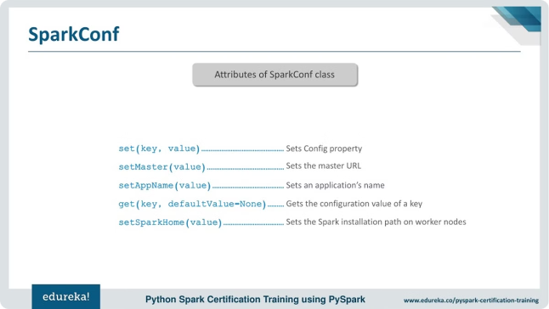
What is SparkConf?
Purpose
Configures Spark application properties.
Function
Sets parameters like master URL, application name, and resource allocation.
Example
conf.setMaster("spark://master:7077").setAppName("MySparkApp")

Slide 8
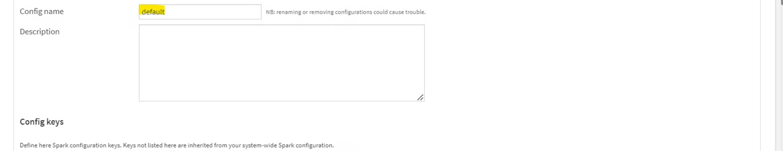




SparkConf Attributes
set
setMaster
setAppName
setSparkHome
Sets a configuration property.
Specifies the master URL for connecting to the Spark cluster.
Sets the name of the Spark application.
Sets the path to the Spark installation directory.

Slide 9
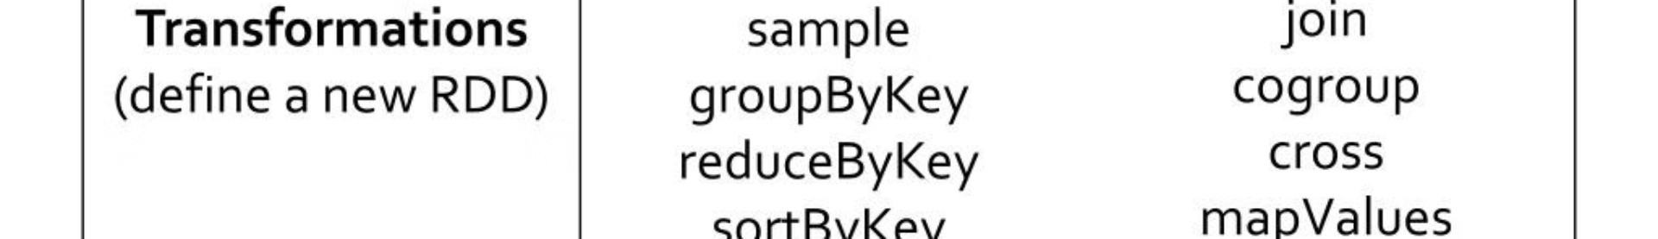



RDD Operations in PySpark
1
Transformations
2
Actions
Operations that create a new RDD from an existing one, such as map, filter, and reduce.
Operations that perform computations on an RDD and return a result, such as collect, count, and reduce.
Actions and Transformations in RDD
Transformations
Actions
Execution
Create a new RDD without computing results immediately.
Trigger the actual computation and return a result.
Spark optimizes execution by combining transformations and only executing actions when necessary.

Slide 10

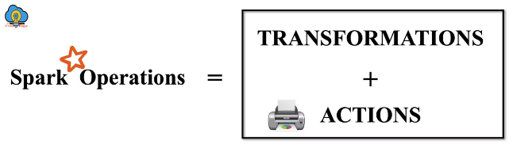
Introduction to RDDs
RDDs are the core of Spark, providing distributed, fault-tolerant, and immutable datasets. They can be created from external data sources or by transforming existing RDDs.

Slide 11
When to Use RDDs
Data Transformations
Custom Data Structures
Legacy Code
RDDs are ideal for performing transformations on large datasets, especially when dealing with complex operations.
If you need to work with data structures not natively supported by DataFrames, RDDs offer greater flexibility.
If you're working with existing code that relies on RDDs, there's no need to rewrite everything.

Slide 12

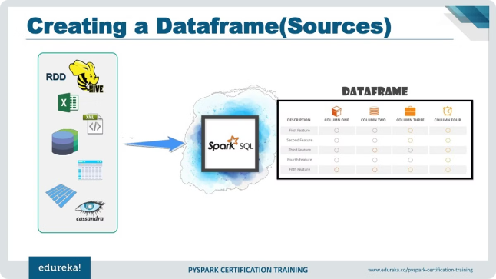
Pyspark DataFrames
DataFrames offer a more structured approach to working with data in Spark. They provide a columnar representation of data, making it easier to perform queries and analysis.
1
Columnar Data
2
SQL Integration
DataFrames store data in a columnar format, making it efficient for querying and analysis.
DataFrames support SQL-like queries, allowing you to leverage familiar SQL syntax for data manipulation.
3
High-Level APIs
Pyspark provides high-level APIs for interacting with DataFrames, simplifying data manipulation tasks.

Slide 13
Pyspark MLlib
MLlib is a machine learning library built on top of Spark. It provides a wide range of algorithms and tools for building machine learning models.
Classification
Regression
Clustering
Algorithms like Logistic Regression, Decision Trees, and Support Vector Machines.
Algorithms like Linear Regression, Decision Trees, and Random Forests.
Algorithms like K-Means, Gaussian Mixture Models, and LDA.

Slide 14
Spark Stack
The Spark stack consists of various components that work together to provide a comprehensive platform for data processing and analysis.
Spark Core
1
The foundation of Spark, providing the core functionalities for distributed computation.
2
Spark SQL
Extends Spark Core to support SQL queries and structured data processing.
Spark Streaming
3
Allows for real-time processing of streaming data, enabling near-instant analysis.
4
MLlib
Provides a machine learning library for building and deploying machine learning models.
GraphX
5
Enables efficient analysis and manipulation of graph-structured data.

Slide 15



Spark Components
Spark components can be categorized based on their roles and functionalities, making it easier to understand the overall architecture.
Category
Examples
Programming Languages
Scala, Java, Python, R
Libraries
Spark SQL, MLlib, GraphX, Spark Streaming
Engine
Spark Core
Cluster Management
YARN, Mesos, Standalone
Storage
HDFS, S3, Local Disk

Slide 16

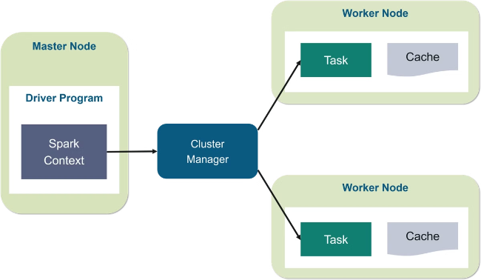

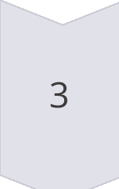
Spark Architecture
Spark architecture consists of key components that work together to distribute and execute applications across a cluster of machines.
Driver
Manages the application execution, sends tasks to executors, and collects results.
Cluster Manager
Responsible for allocating resources and launching executors on worker nodes.
Executor
Runs tasks assigned by the driver and communicates with the driver to send results.

Slide 17





Spark Deployment Modes
Spark offers various deployment modes to fit different cluster management and resource allocation needs.
Spark Standalone
Spark on Apache Mesos
Spark on Hadoop YARN
Spark on Amazon EC2
A simple deployment mode where Spark manages its own cluster resources.
Uses the Mesos cluster manager for resource allocation and scheduling.
Leverages YARN (Yet Another Resource Negotiator) for resource management in a Hadoop environment.
Deploys Spark applications on Amazon Elastic Compute Cloud (EC2) for scalable cloud computing.
Spark on Kubernetes
Utilizes Kubernetes for containerized deployment and resource management.

Slide 18
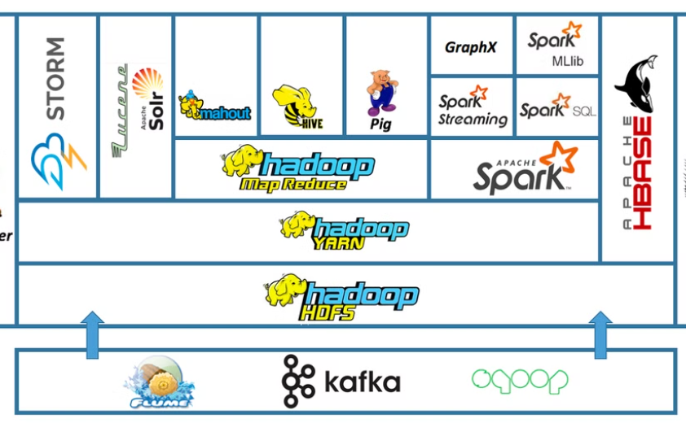
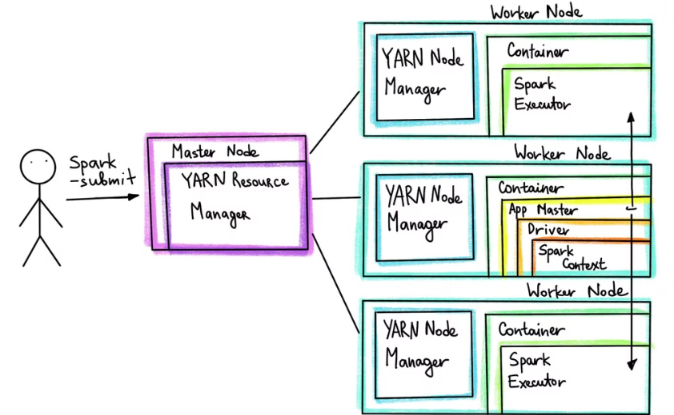
Running Spark Applications on YARN
YARN provides a resource management framework, enabling Spark applications to leverage resources within a Hadoop ecosystem.
YARN Architecture
Spark on YARN
YARN manages the resources and scheduling of applications running on a Hadoop cluster.
Spark utilizes YARN for resource management and scheduling, integrating seamlessly with the Hadoop environment.

Slide 19
PySpark RDDs: A Deep Dive
Resilient Distributed Datasets (RDDs) are the fundamental data structures in Apache Spark. They provide a powerful abstraction for working with distributed data, enabling parallel processing and fault tolerance. Let's explore the key features of RDDs and how they function within the PySpark ecosystem.

Slide 20
Features of PySpark RDDs
1
In-Memory Computations
2
Immutable and Read-Only
RDDs are designed for fast processing, enabling computations to occur within memory, minimizing disk access and accelerating execution times.
Once created, RDDs are immutable and read-only. This ensures data consistency and facilitates parallel processing across distributed nodes.
3
Lazy Evaluation
4
Cacheable
RDD transformations are lazily evaluated, meaning they are not executed until an action is performed. This optimizes execution by delaying computations until necessary.
RDDs can be cached in memory for efficient reuse. This is particularly useful for frequently accessed data, reducing redundant computations and improving performance.
5
Parallel Data Processing
6
Typed
RDDs enable parallel processing by distributing data across multiple nodes, enabling faster execution and better resource utilization.
RDDs can be typed, allowing for strong type checks and improved data integrity during computations.

Slide 21

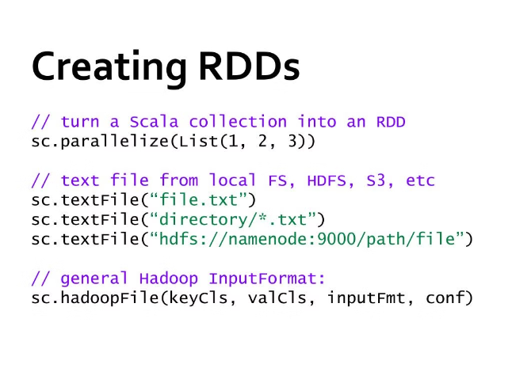
Ways to Create Spark RDDs using PySpark
From a Python List
From a Text File
Create an RDD directly from a Python list of elements.
Load an RDD from a text file, processing each line as a separate element.
From a Sequence File
From an External Dataset
Read data from a sequence file, which is a binary format commonly used for storing key-value pairs.
Load data from external sources such as Hive tables, databases, or other file formats.

Slide 22

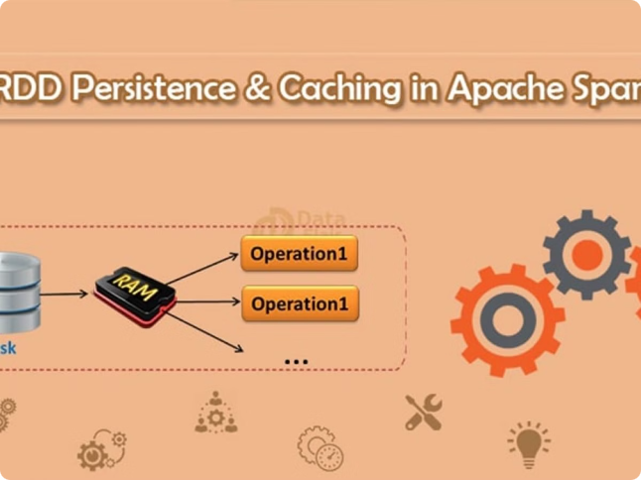
RDD Persistence and Caching
RDD persistence allows you to store RDDs in memory for efficient reuse. This is useful when the same RDD is needed for multiple operations, reducing redundant data loading and processing. Caching is a form of persistence, but it uses a memory-based approach, providing faster access.

Slide 23

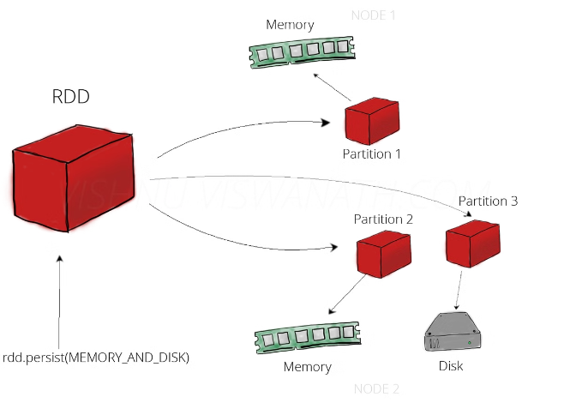
RDD Persistence Levels
MEMORY_ONLY
Stores the RDD in memory only, potentially leading to data loss if the executor fails.
MEMORY_AND_DISK
Stores the RDD in memory; if memory runs out, it spills to disk, preserving data even if executors fail.
MEMORY_ONLY_SER
Stores the RDD in memory, serializing it for more efficient memory usage.
MEMORY_AND_DISK_SER
Stores the RDD in memory, serializing it for more efficient memory usage; if memory runs out, it spills to disk.
DISK_ONLY
Stores the RDD on disk only, suitable for large datasets that don't fit in memory.

Slide 24

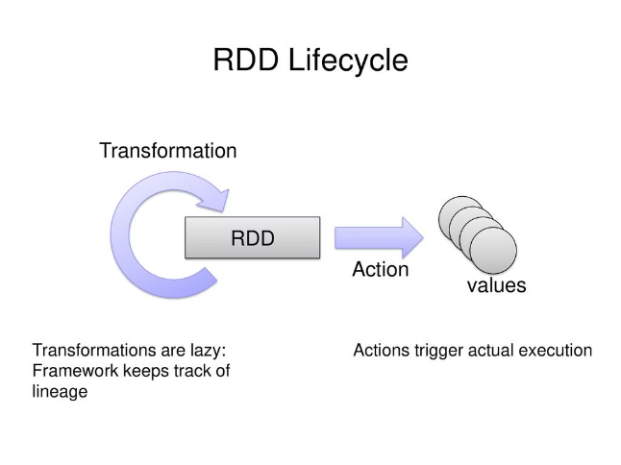
Operations on RDDs: Action and Transformation Flow Diagram
1
Transformations
These operations transform an RDD into a new RDD without immediate execution.
2
Actions
These operations trigger computations on an RDD and return a result, like a value or a collection.

Slide 25
Narrow Transformations in RDD with Examples
map()
filter()
flatMap()
Applies a function to each element of the RDD.
Filters elements based on a condition.
Applies a function that can return multiple elements for each input element.
rdd = sc.parallelize([1, 2, 3, 4, 5])\nfiltered_rdd = rdd.filter(lambda x: x > 2)\nprint(filtered_rdd.collect())
rdd = sc.parallelize([1, 2, 3])\nmapped_rdd = rdd.map(lambda x: x * 2)\nprint(mapped_rdd.collect())
rdd = sc.parallelize(["hello", "world"])\nflat_mapped_rdd = rdd.flatMap(lambda x: list(x))\nprint(flat_mapped_rdd.collect())

Slide 26
Wide Transformations in RDD with Examples
reduceByKey()
Groups elements by key and applies a reduction function.
rdd = sc.parallelize([('a', 1), ('b', 2), ('a', 3)])
reduced_rdd = rdd.reduceByKey(lambda x, y: x + y)
print(reduced_rdd.collect())
join()
Joins two RDDs based on a common key.
rdd1 = sc.parallelize([('a', 1), ('b', 2)])
rdd2 = sc.parallelize([('a', 3), ('c', 4)])
joined_rdd = rdd1.join(rdd2)\nprint(joined_rdd.collect())
groupByKey()
Groups elements by key, creating an Iterable of values for each key.
rdd = sc.parallelize([('a', 1), ('b', 2), ('a', 3)])
grouped_rdd = rdd.groupByKey()
print(grouped_rdd.collect())

Slide 27
Transformations on Paired RDDs with Example
mapToPair()
Transforms each element of an RDD into a key-value pair.
rdd = sc.parallelize([1, 2, 3])
paired_rdd = rdd.mapToPair(lambda x: (x, x * 2))
print(paired_rdd.collect())
sortByKey()
Sorts an RDD by key.
rdd = sc.parallelize([('b', 2), ('a', 1), ('c', 3)])
sorted_rdd = rdd.sortByKey()
print(sorted_rdd.collect())
cogroup()
Groups elements from two RDDs based on a common key, creating an Iterable of values for each key from both RDDs.
rdd1 = sc.parallelize([('a', 1), ('b', 2)])
rdd2 = sc.parallelize([('a', 3), ('c', 4)])
cogrouped_rdd = rdd1.cogroup(rdd2)\nprint(cogrouped_rdd.collect())

Slide 28
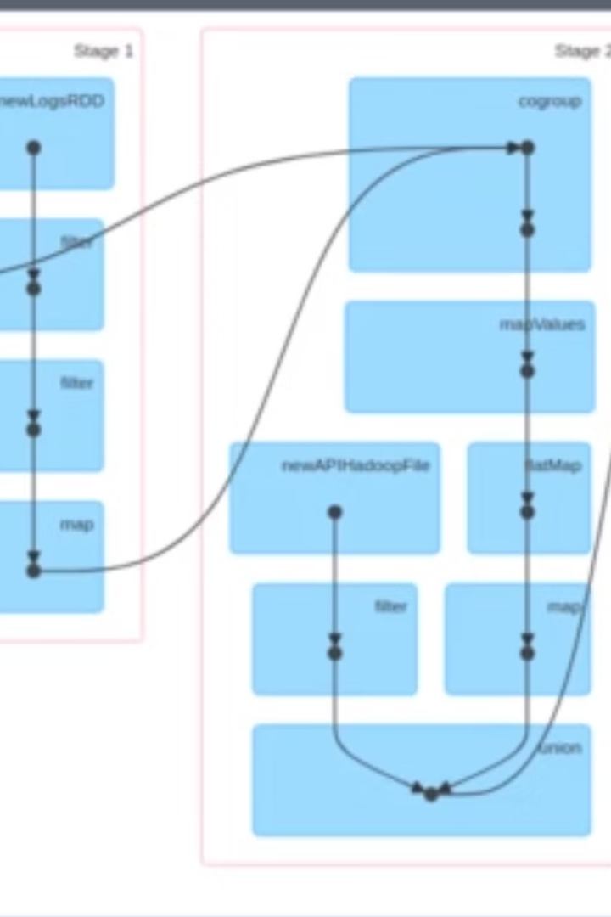
RDD Lineage with Example Code of debugString
RDD lineage represents the dependencies between RDDs, showing how they are derived from one another. This lineage information is crucial for optimization and fault tolerance in Spark. The `debugString()` method provides a textual representation of an RDD's lineage, allowing you to understand its creation and transformation history.
rdd = sc.parallelize([1, 2, 3])
mapped_rdd = rdd.map(lambda x: x * 2)
print(mapped_rdd.toDebugString())

Slide 29

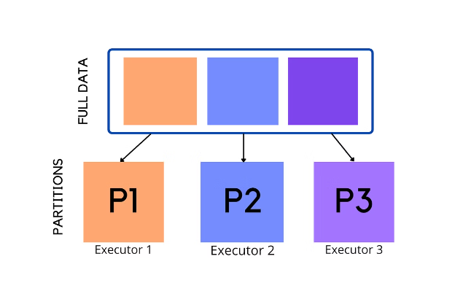
RDD Partitioning
Data is organized into partitions in RDD, the core data structure in Spark. RDDs can be partitioned based on different criteria to optimize performance and efficiently process large datasets.

Slide 30

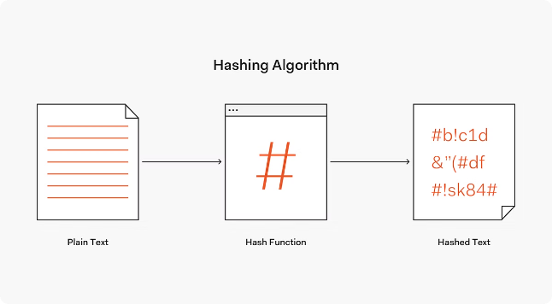
Hash Partitioning in RDD
Hash partitioning uses a hash function to assign keys to specific partitions. The hash function takes the key as input and produces a hash value, which determines the partition.
1
Even Distribution
2
Key-Value Pairs
It distributes data evenly across partitions, ensuring balanced workload and parallel processing.
It works best for key-value pairs where you want to group data with similar keys together.
3
Data Skew
Hash partitioning can be sensitive to data skew, where some partitions may become overloaded with data.

Slide 31
Range Partitioning in RDD
Range partitioning divides the data into partitions based on the range of values of a specific attribute. It's useful for handling continuous data and performing operations based on value ranges.
Range Partitioning
Sorted Data
It assigns keys to partitions based on their value range.
Works best for data that is already sorted or needs to be sorted for efficient processing.
Key values are compared to the defined ranges.
Data is distributed based on the range it falls in.
Data within a partition is sorted based on the partition key.
It enhances performance for operations like range queries.

Slide 32

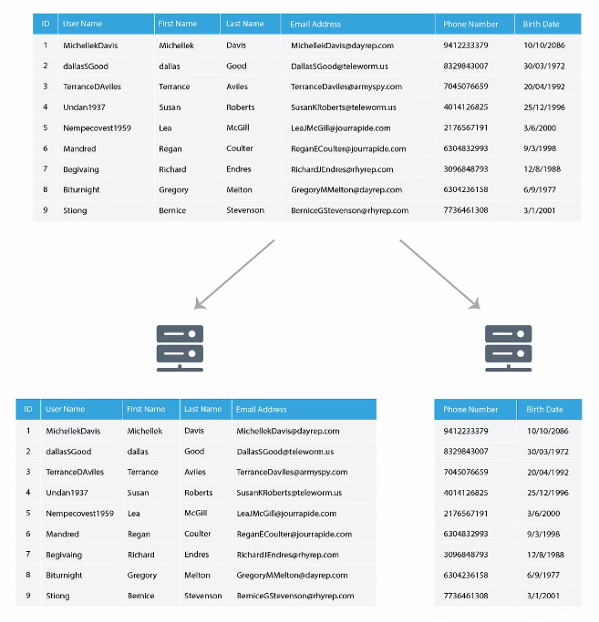

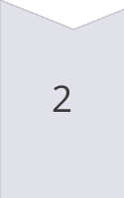
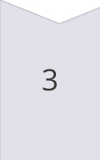
Hash Partitioner with Diagram
A hash partitioner distributes data based on the output of a hash function. The hash function maps each key to a unique integer value, which then determines the partition assignment.
Data Entry
Data is received, such as a key-value pair.
Hash Function
The hash function is applied to the key.
Partition Assignment
The hash value is used to determine the partition for the data.

Slide 33

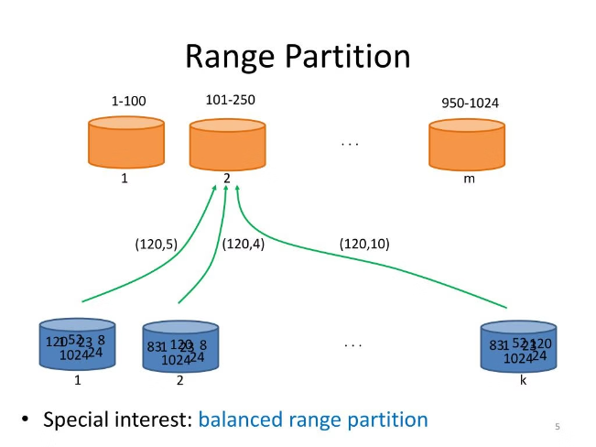
Range Partitioner with Diagram
A range partitioner divides data into partitions based on the range of values of a key. Data is assigned to a partition based on the value range it belongs to.
Data Split
Partition Assignment
Data is divided into partitions based on the range of values.
Data is assigned to the partition whose range includes its value.
1
2
3
Range Definition
A range of values is defined for each partition.

Slide 34

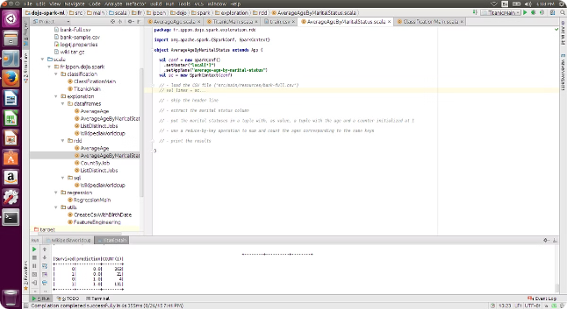
Passing Functions to Spark with Examples
Spark allows you to pass functions to perform transformations and actions on RDDs. You can use lambda functions or define custom functions for data processing.
Transformations
Actions
map()
collect()
filter()
reduce()
flatMap()
foreach()

Slide 35
Spark Cluster and Client Deployment
Spark offers flexible deployment options, allowing you to choose the best fit for your needs. You can run Spark in either cluster or client mode, each with its own advantages.

Slide 36
Cluster and Client Mode
Cluster Mode
Client Mode
The Spark application runs on a cluster of machines. It's more efficient for large-scale data processing and provides better resource utilization.
The Spark application runs on the same machine as the client. It's more convenient for development and testing, as you can see the logs and output directly on your machine.
To launch Spark in cluster mode, use the following command:
To launch Spark in client mode, use the following command:
spark-submit --master spark://master-node:7077 your_application.py
spark-submit --master local your_application.py

Slide 37
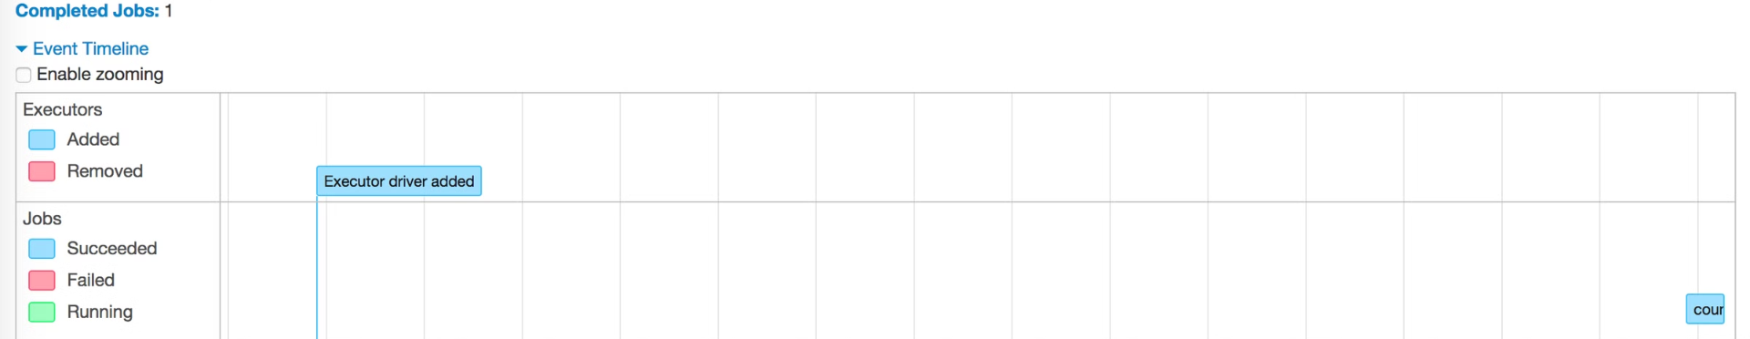
Spark Shell
Interactive Shell
Code Execution
Data Exploration
The Spark shell provides an interactive environment for experimenting with Spark, writing and testing code, and exploring data.
It allows you to execute Spark commands and see the results immediately, making it ideal for learning and prototyping.
You can load data, transform it, and analyze it directly within the shell, facilitating quick experimentation and data discovery.

Slide 38

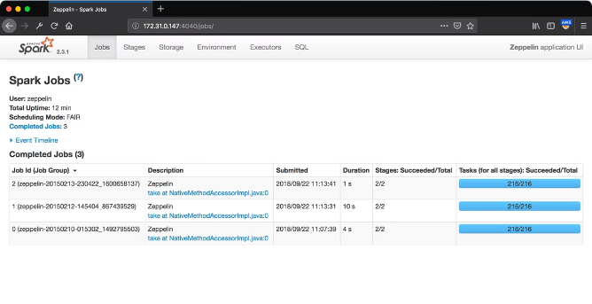
Spark Web UI
Jobs
Provides an overview of all running and completed Spark applications, including their status, duration, and resources used.
Stages
Displays the stages of a Spark job, including their duration, number of tasks, and execution status.
Storage
Shows the data stored in memory and on disk, including RDDs, broadcast variables, and accumulators.
Environment
Provides information about the Spark environment, such as the JVM, executors, and system properties.
Executors
Displays the details of each executor running your Spark application, including their memory usage, CPU utilization, and task completion time.

Slide 39

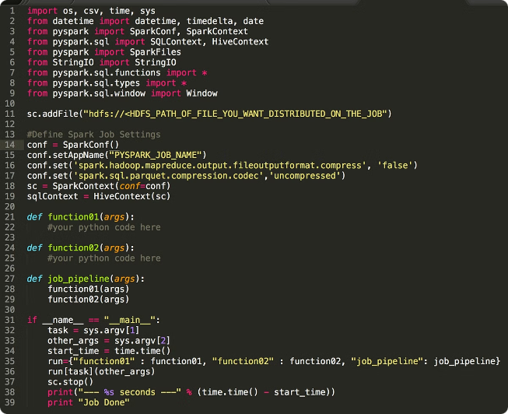
Submitting a PySpark Job
from pyspark.sql import SparkSession # Create a SparkSession spark = SparkSession.builder.appName("MyPySparkJob").getOrCreate() # Read data from a file df = spark.read.csv("data.csv", header=True, inferSchema=True) # Perform data analysis and transformations # ... # Write results to a file df.write.csv("results.csv") # Stop the SparkSession spark.stop()

Slide 40

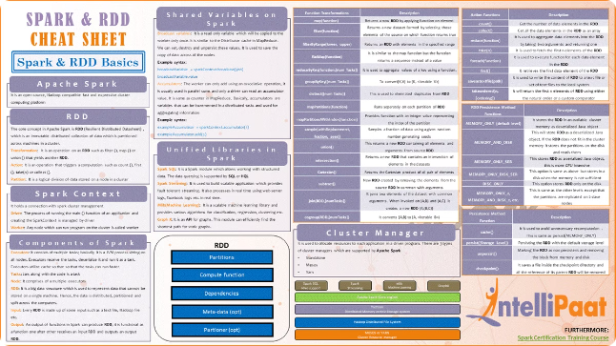
Spark RDDs
1
Resilient Distributed Datasets (RDDs)
2
In-Memory Computations
RDDs are fundamental data structures in Spark, representing a collection of elements distributed across a cluster of machines.
RDDs can be processed in memory, enabling fast and efficient data analysis.
3
Lazy Evaluation
4
Fault Tolerance
Computations on RDDs are only executed when needed, allowing for optimization and resource efficiency.
RDDs are fault-tolerant, meaning they can recover from node failures without losing data.

Slide 41
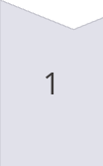
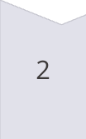
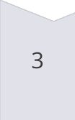
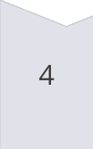
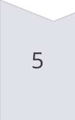
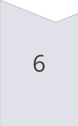
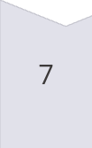
Spark RDD Functions
In-Memory Computations
RDDs are stored in memory for fast processing, minimizing disk access time.
Lazy Evaluations
Computations are deferred until a result is needed, optimizing resource usage and enabling transformations on large datasets.
Fault Tolerant
RDDs are resilient to node failures, ensuring data integrity and continuity during processing.
Immutable
RDDs are immutable, meaning their contents cannot be changed once created, ensuring data consistency and predictability.
Partitioning
RDDs are partitioned across multiple nodes for parallel processing, enhancing performance and scalability.
Persistence
RDDs can be persisted in memory or on disk, allowing for reuse and faster access in subsequent computations.
Coarse Grained Operations
RDDs support efficient parallel processing of large datasets through coarse-grained operations, maximizing computational throughput.

Slide 42

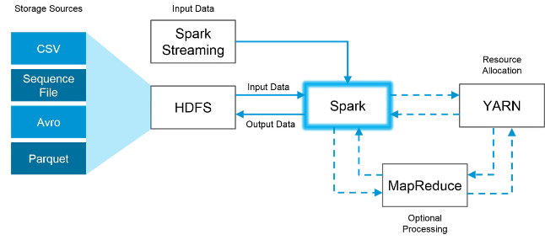
Spark RDD Workflow
1
Data Loading
RDDs are created by loading data from various sources like files, databases, or external systems.
2
Transformations
Data transformations are applied to RDDs to manipulate and process the data, creating new RDDs.
3
Actions
Actions trigger the execution of transformations and produce final results, such as collecting data or saving it to a file.

Slide 43


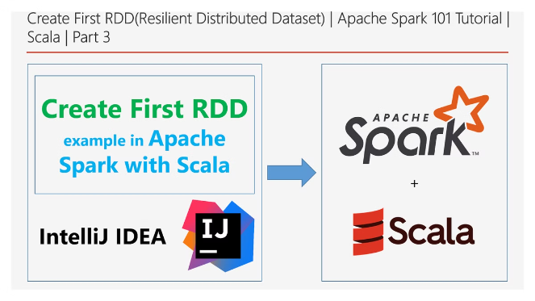


RDDs: Solving Existing Problems
In-Disk Computation
RDDs address the issue of in-disk computation by storing data in memory, enabling faster processing and reducing disk I/O overhead.
Job Execution
RDDs simplify job execution by providing a distributed, fault-tolerant framework for managing and coordinating tasks across multiple nodes.
Parallel Processing
RDDs enable parallel processing by partitioning data across multiple nodes, allowing for simultaneous execution of operations on different data subsets.

